Slide 1
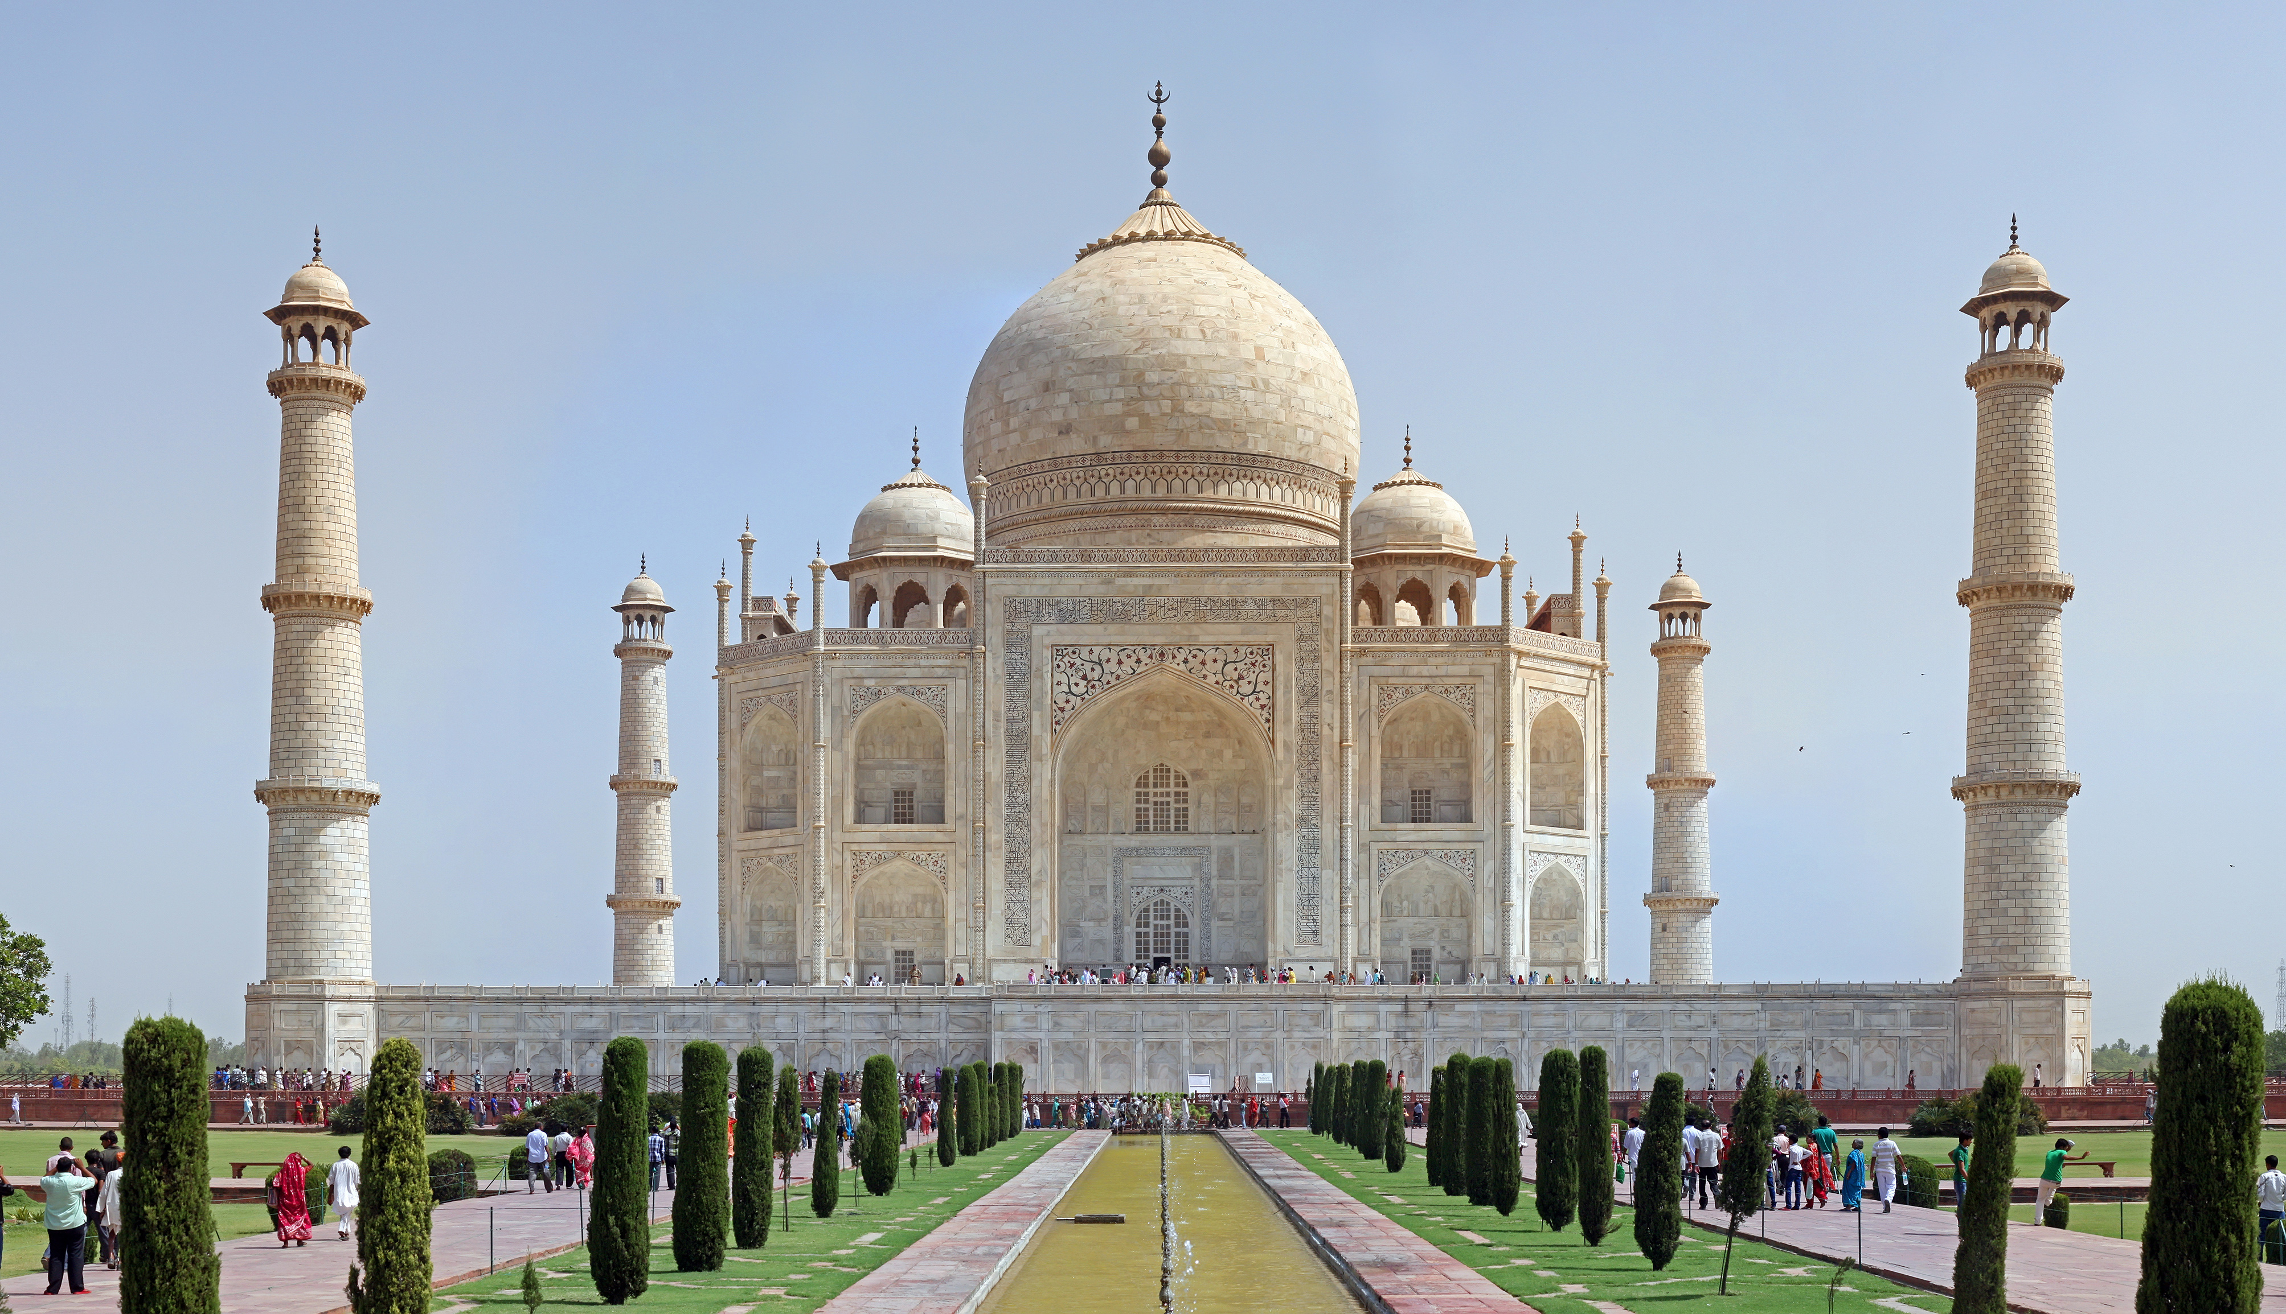
About taj mahal

Slide 2
The Taj Mahal, located in Agra, India, is a stunning white marble mausoleum built by Emperor Shah Jahan in memory of his wife Mumtaz Mahal. Recognized as a symbol of love and a masterpiece of Mughal architecture, it is one of the Seven Wonders of the World.

Slide 3
Special key word
Location: Agra, Uttar Pradesh, India
Built by: Shah Jahan
In memory of: Mumtaz Mahal
Construction period: 1632–1653
Architectural style: Mughal, Islamic, Persian, Indian

